Slide 1
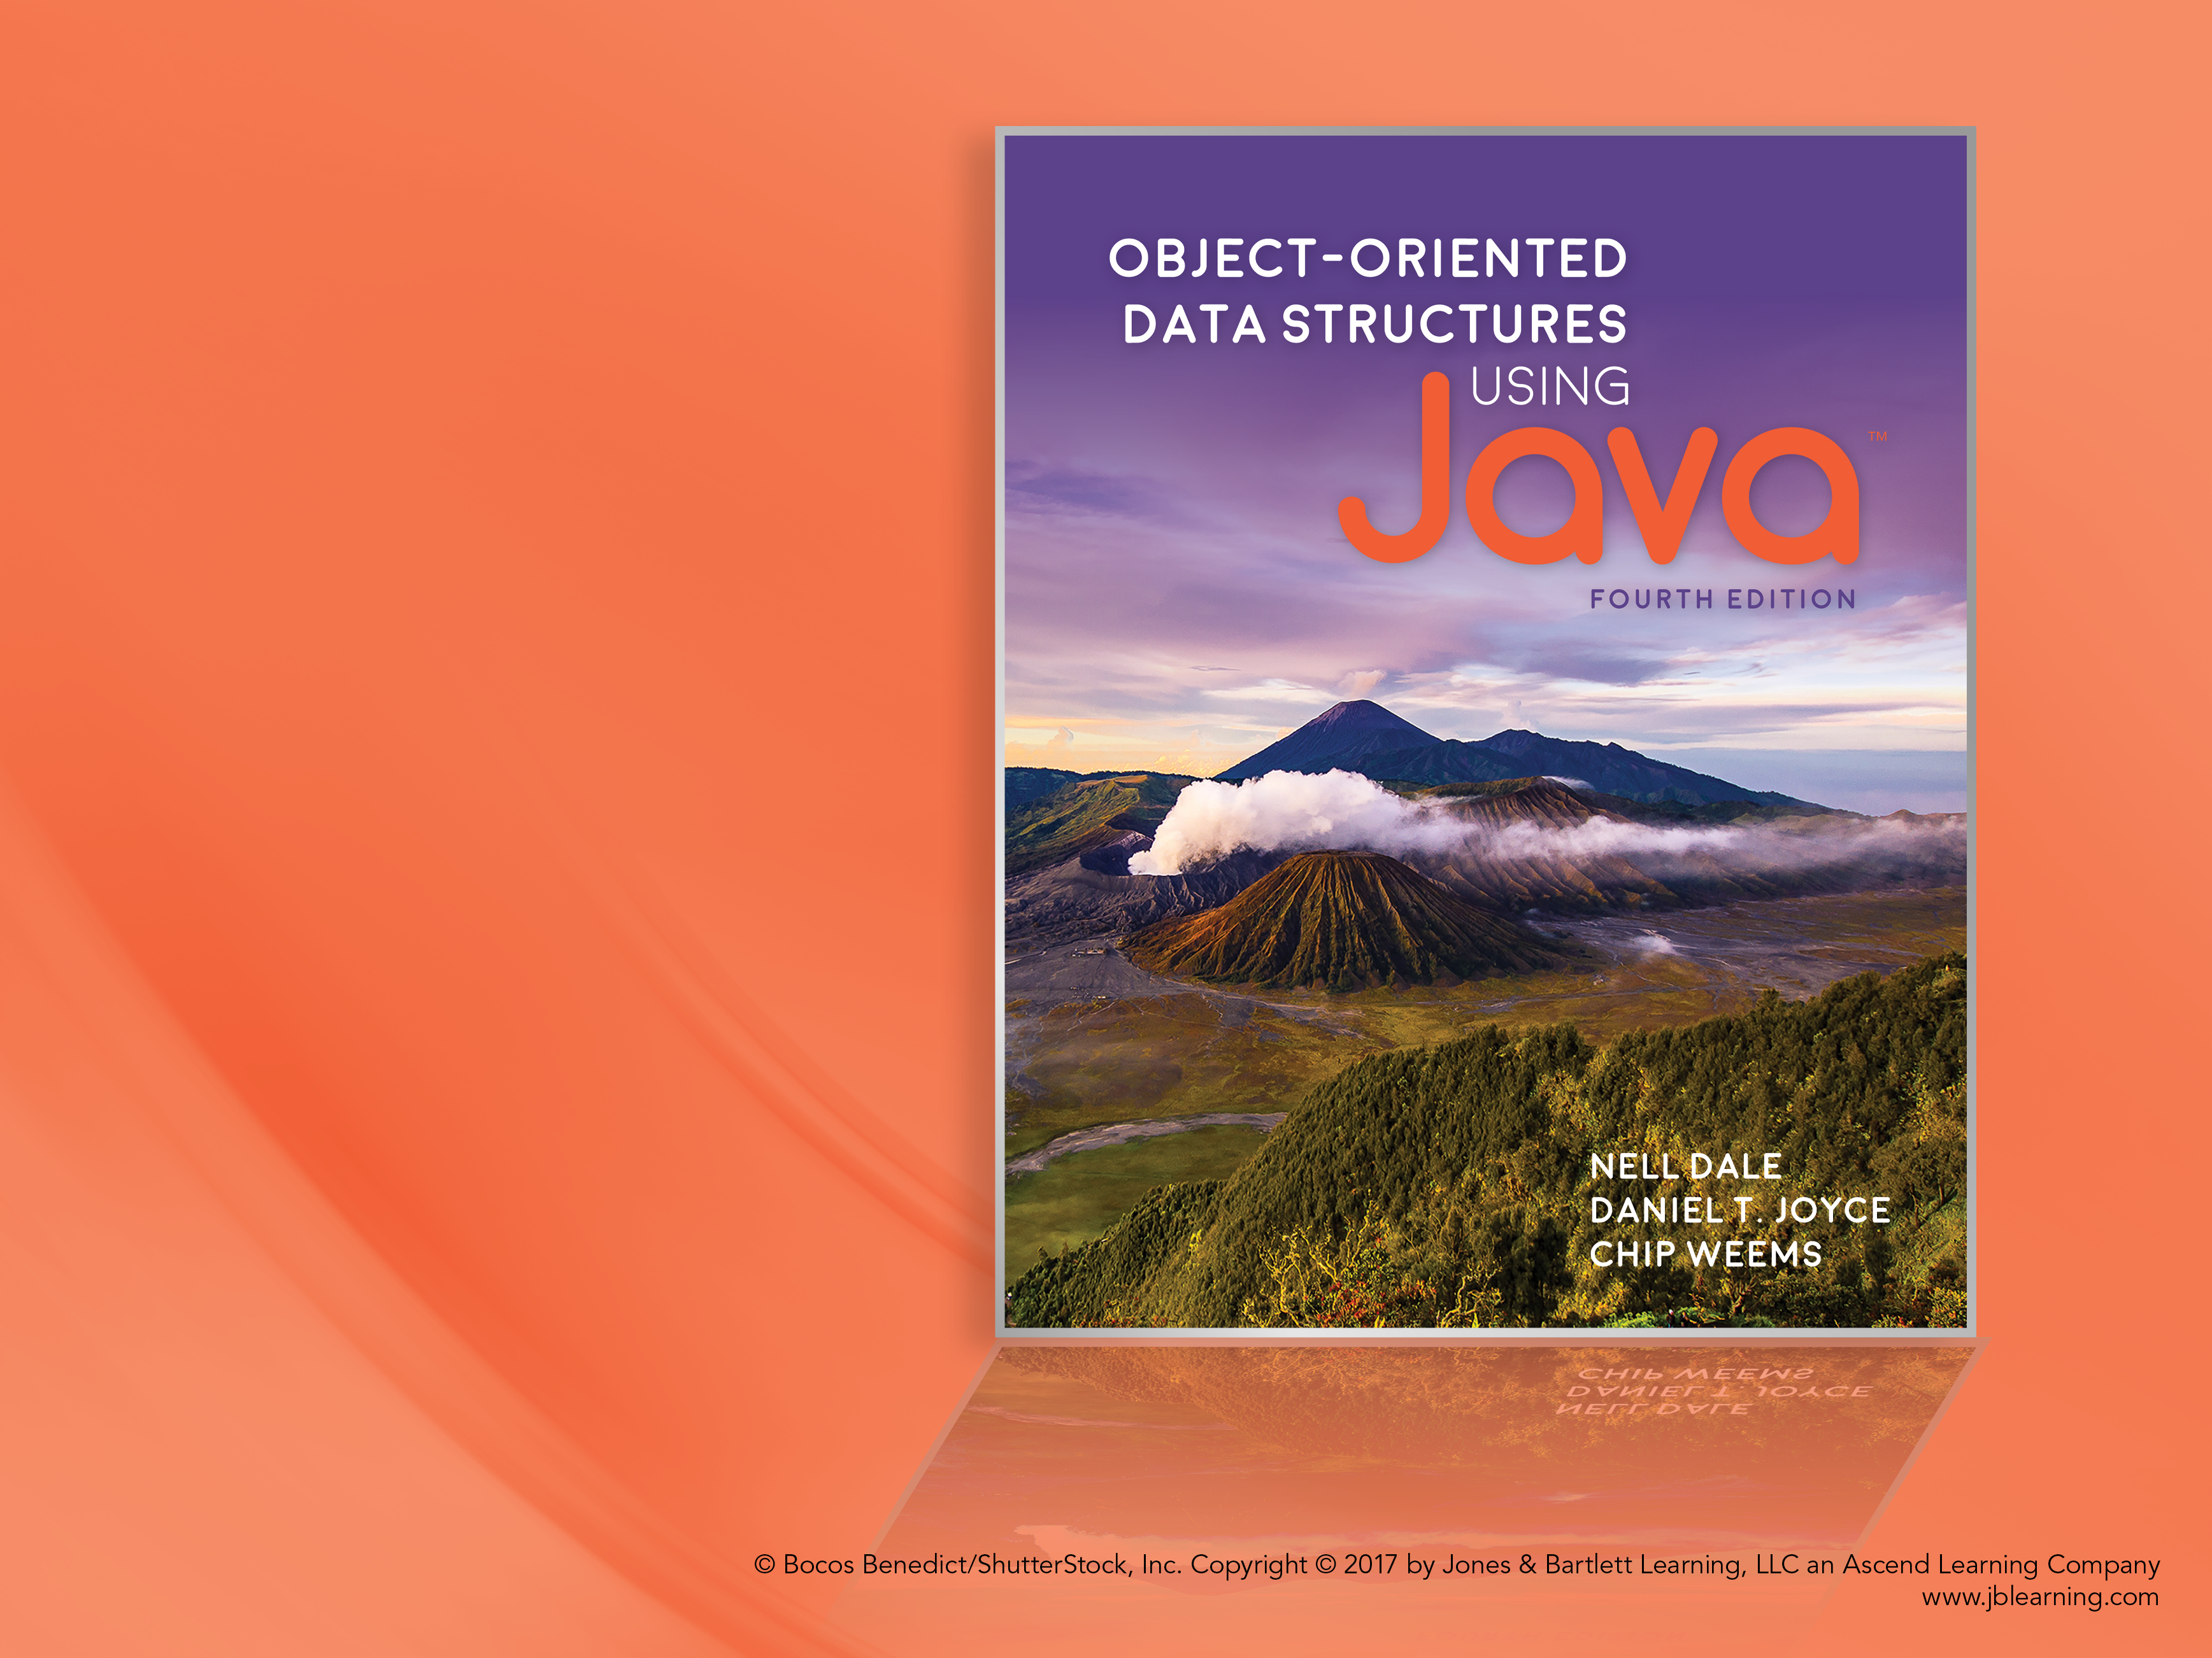
Chapter 10 The Graph ADT

Slide 2
Chapter 10: The Graph ADT
10.1 – Introduction to Graphs
10.2 – The Graph Interface
10.3 – Implementations of Graphs
10.4 – Application: Graph Traversals
10.5 – Application: The Single-Source Shortest-Paths
Problem

Slide 3
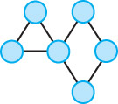
10.1 Introduction to Graphs

Slide 4
Definitions
Graph: A data structure that consists of a set of vertices and a set of edges that relate the vertices to each other
Vertex: A node in a graph
Edge (arc): A pair of vertices representing a connection between the two vertices in a graph
Undirected graph: A graph in which the edges have no direction
Directed graph (digraph): A graph in which each edge is directed from one vertex to another (or the same) vertex

Slide 5
Formally
a graph G is defined as follows:
G = (V,E)
where
V(G) is a finite, nonempty set of vertices
E(G) is a set of edges (written as pairs
of vertices)

Slide 6
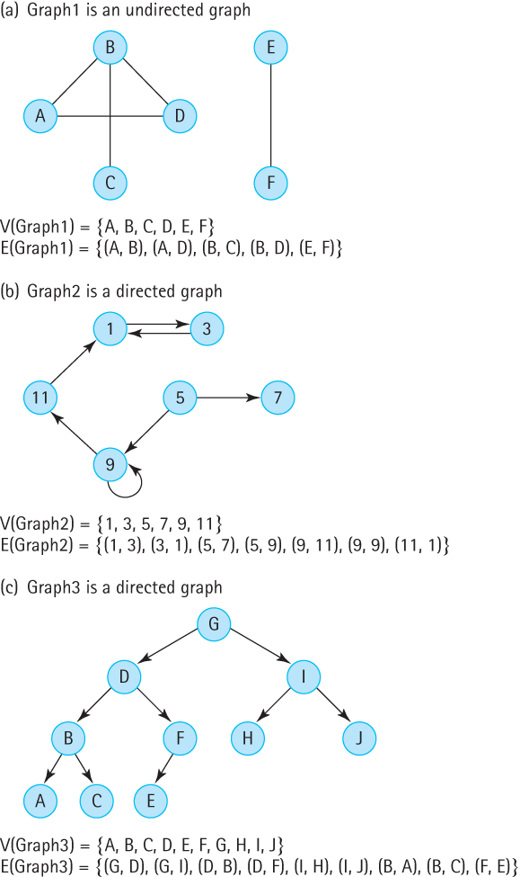

Slide 7
More Definitions
Adjacent vertices: Two vertices in a graph that are connected by an edge
Path: A sequence of vertices that connects two vertices in a graph
Complete graph: A graph in which every vertex is directly connected to every other vertex
Weighted graph: A graph in which each edge carries a value

Slide 8
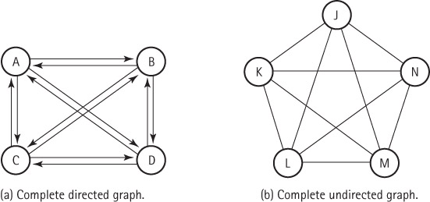
Two complete graphs

Slide 9
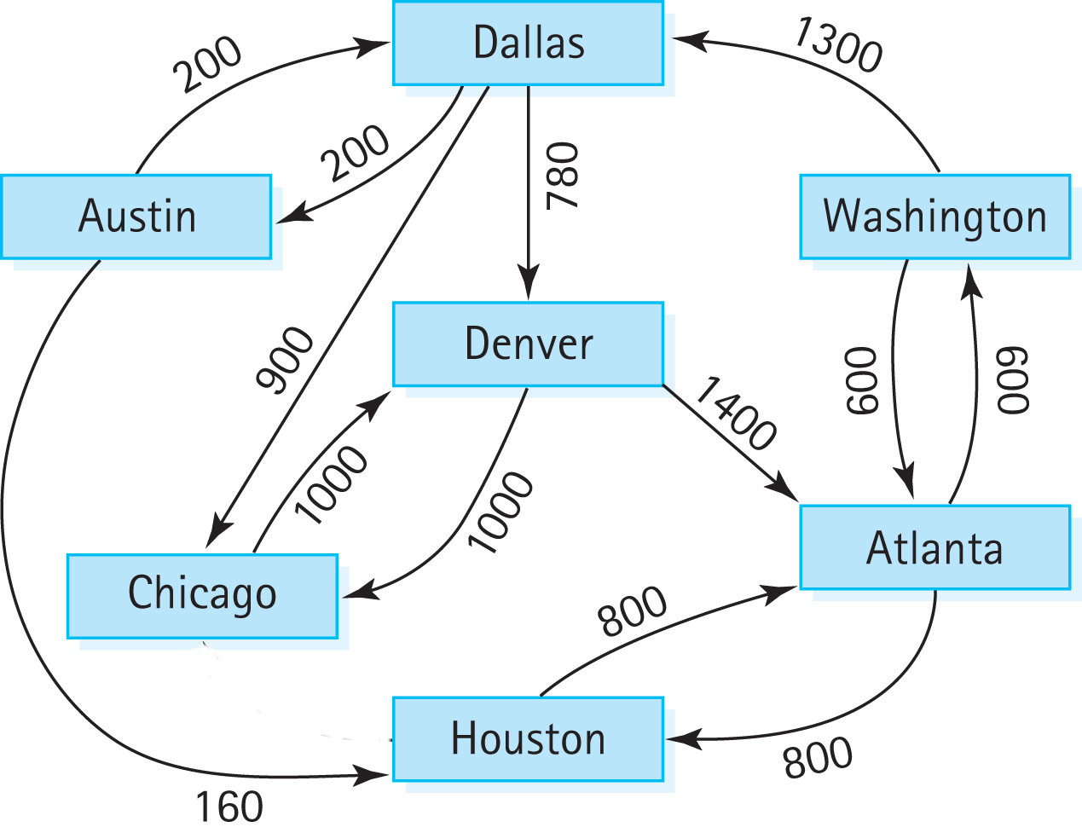
A weighted graph

Slide 10
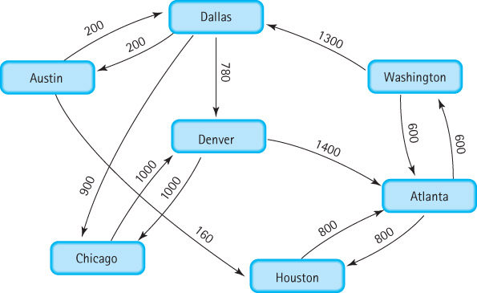
10.2 The Graph Interface
What kind of questions might we ask about a graph?
Does a path exist between vertex A and vertex D? Can we fly from Atlanta to Detroit?
What is the total weight along this path from A to D? How much does it cost to fly from Atlanta to Detroit? What is the total distance?
What is the shortest path from A to D? What is the cheapest way to get from Atlanta to Detroit?
If I start at vertex A, where can I go? What cities are accessible if I start in Atlanta?
How many connected components are in the graph? What groups of cities are connected to each other?

Slide 11
Graph Operations
What kind of operations are defined on a graph?
We specify and implement a small set of useful graph operations
Many other operations on graphs can be defined; we have chosen operations that are useful when building applications to answer typical questions, such as those found on the previous slide

Slide 12
WeightedGraphInterface.java part I
//----------------------------------------------------------------------------
// WeightedGraphInterface.java by Dale/Joyce/Weems Chapter 10
//
// Interface for classes that implement a directed graph with weighted edges.
// Vertices are objects of class T and can be marked as having been visited.
// Edge weights are integers.
// Equivalence of vertices is determined by the vertices' equals method.
//
// General precondition: except for the addVertex and hasVertex methods,
// any vertex passed as an argument to a method is in this graph.
//----------------------------------------------------------------------------
package ch10.graphs;
import ch04.queues.*;
public interface WeightedGraphInterface<T>
{
boolean isEmpty();
// Returns true if this graph is empty; otherwise, returns false.
boolean isFull();
// Returns true if this graph is full; otherwise, returns false.

Slide 13
WeightedGraphInterface.java part II
void addVertex(T vertex);
// Preconditions: This graph is not full.
// vertex is not already in this graph.
// vertex is not null.
//
// Adds vertex to this graph.
boolean hasVertex(T vertex);
// Returns true if this graph contains vertex; otherwise, returns false.
void addEdge(T fromVertex, T toVertex, int weight);
// Adds an edge with the specified weight from fromVertex to toVertex.
int weightIs(T fromVertex, T toVertex);
// If edge from fromVertex to toVertex exists, returns the weight of edge;
// otherwise, returns a special “null-edge” value.

Slide 14
WeightedGraphInterface.java part III
UnboundedQueueInterface<T> getToVertices(T vertex);
// Returns a queue of the vertices that vertex is adjacent to.
void clearMarks();
// Unmarks all vertices.
void markVertex(T vertex);
// Marks vertex.
boolean isMarked(T vertex);
// Returns true if vertex is marked; otherwise, returns false.
T getUnmarked();
// Returns an unmarked vertex if any exist; otherwise, returns null.
}

Slide 15
10.3 Implementations of Graphs
In this section we introduce two graph implementation approaches
an array based approach
a linked approach

Slide 16
Array-Based Implementation
Adjacency matrix For a graph with N nodes, an N by N table that shows the existence (and weights) of all edges in the graph
With this approach a graph consists of
an integer variable numVertices
a one-dimensional array vertices
a two-dimensional array edges (the adjacency matrix)

Slide 17
A repeat of the abstract model

Slide 18
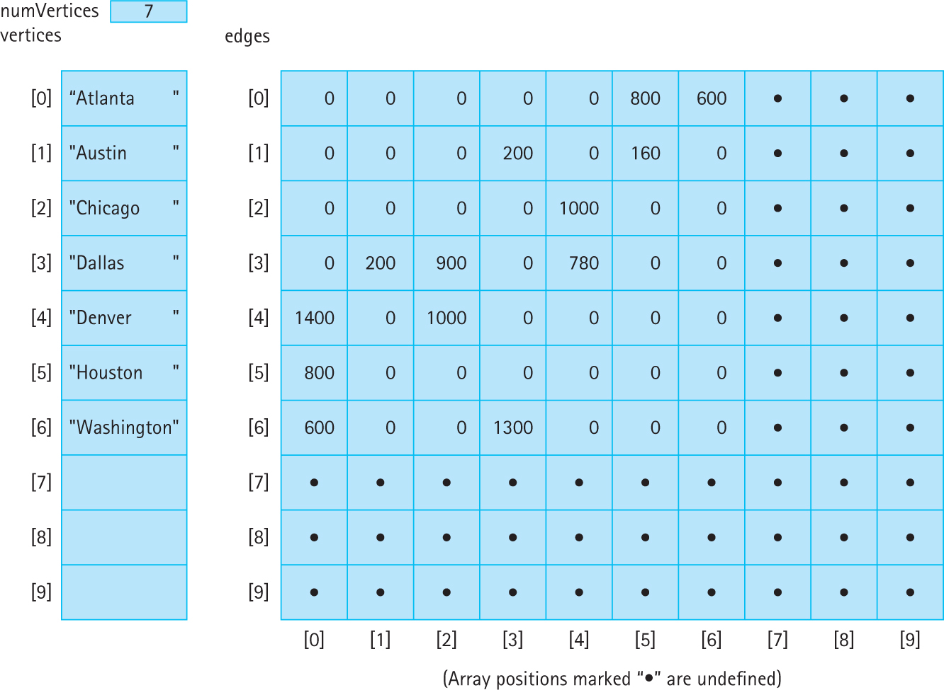
The array-based implementation

Slide 19
WeightedGraph.java instance variables
package ch10.graphs;
import ch04.queues.*;
public class WeightedGraph<T> implements WeightedGraphInterface<T>
{
public static final int NULL_EDGE = 0;
private static final int DEFCAP = 50; // default capacity
private int numVertices;
private int maxVertices;
private T[] vertices;
private int[][] edges;
private boolean[] marks; // marks[i] is mark for vertices[i]
. . .

Slide 20
WeightedGraph.java Constructors
public WeightedGraph()
// Instantiates a graph with capacity DEFCAP vertices.
{
numVertices = 0;
maxVertices = DEFCAP;
vertices = (T[ ]) new Object[DEFCAP];
marks = new boolean[DEFCAP];
edges = new int[DEFCAP][DEFCAP];
}
public WeightedGraph(int maxV)
// Instantiates a graph with capacity maxV.
{
numVertices = 0;
maxVertices = maxV;
vertices = (T[ ]) new Object[maxV];
marks = new boolean[maxV];
edges = new int[maxV][maxV];
}
...

Slide 21
Adding a vertex
public void addVertex(T vertex)
// Preconditions: This graph is not full.
// Vertex is not already in this graph.
// Vertex is not null.
//
// Adds vertex to this graph.
{
vertices[numVertices] = vertex;
for (int index = 0; index < numVertices; index++)
{
edges[numVertices][index] = NULL_EDGE;
edges[index][numVertices] = NULL_EDGE;
}
numVertices++;
}
Textbook also includes code for indexIs, addEdge,
weightIs, and getToVertices.
Coding the remaining methods is left as an exercise.

Slide 22
Linked Implementation
Adjacency list A linked list that identifies all the vertices to which a particular vertex is connected; each vertex has its own adjacency list
We look at two alternate approaches:
use an array of vertices that each contain a reference to a linked list of nodes
use a linked list of vertices that each contain a reference to a linked list of nodes

Slide 23
A repeat of the abstract model

Slide 24
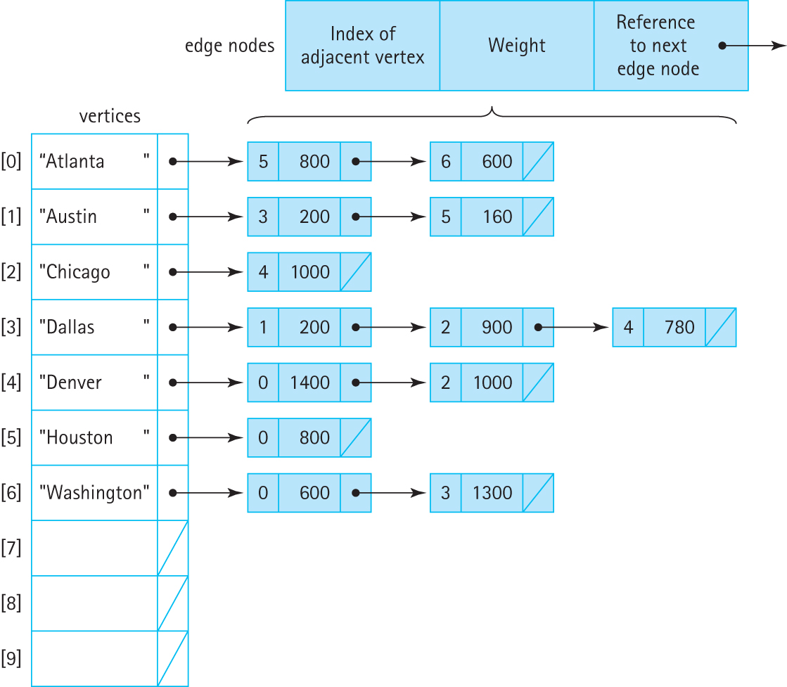
The first link-based implementation

Slide 25
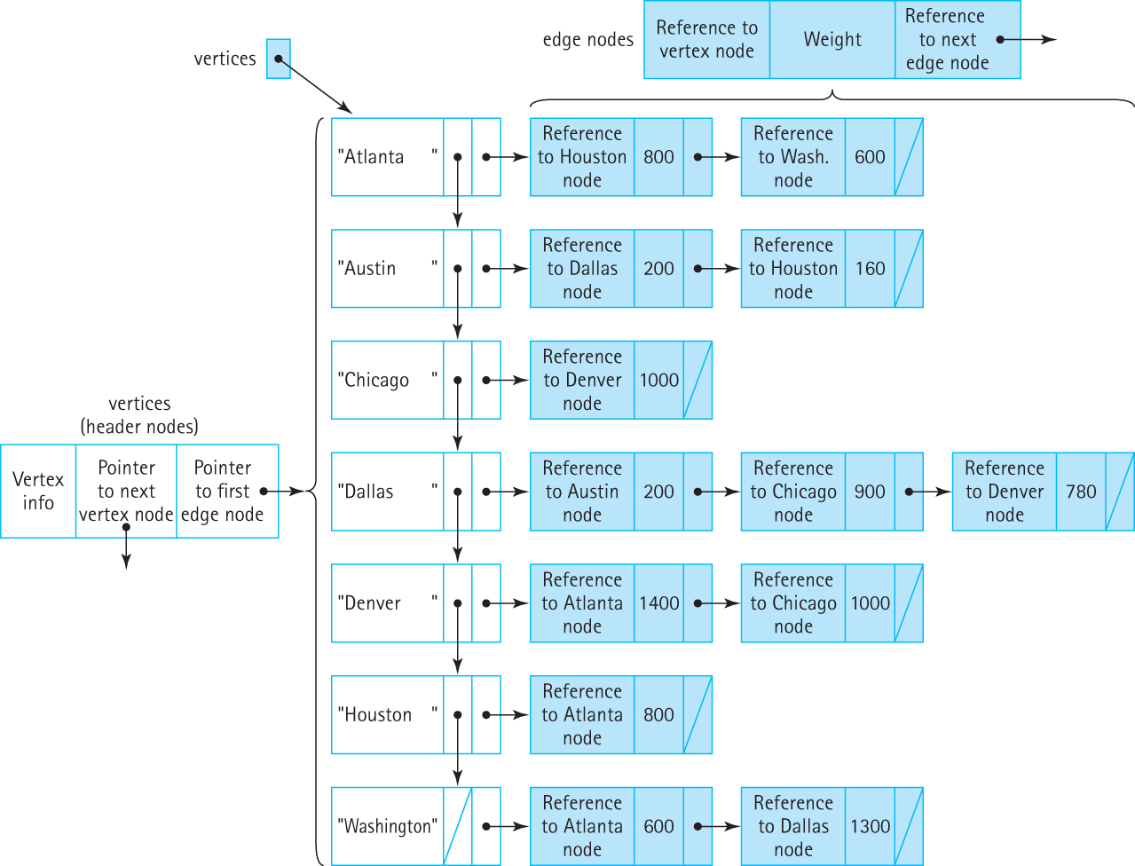
The second link-based implementation

Slide 26
10.4 Application: Graph Traversals
Our graph specification does not include traversal operations.
We treat traversal as a graph application rather than an innate operation.
The basic operations given in our specification allow us to implement different traversals independent of how the graph itself is actually implemented.
The application UseGraph in the ch10.apps package contains the code for all the algorithms presented in Sections 10.4 and 10.5

Slide 27
Graph Traversal
As we did for general trees, we look at two types of graph traversal:
The strategy of going as far as we can and then backtracking is called a depth-first strategy.
The strategy of fanning out “level by level” is called a breadth-first strategy.
We discuss algorithms for employing both strategies within the context of determining if two cities are connected in our airline example.

Slide 28
Can we get from Austin to Washington?

Slide 29
Algorithm: IsPathDF (startVertex, endVertex): returns boolean
Set found to false
Clear all marks
Mark the startVertex
Push the startVertex onto the stack
do
Set current vertex = stack.top()
stack.pop()
if current vertex equals endVertex
Set found to true
else
for each adjacent vertex
if adjacent vertex is not marked
Mark the adjacent vertex and
Push it onto the stack
while !stack.isEmpty() AND !found
return found

Slide 30
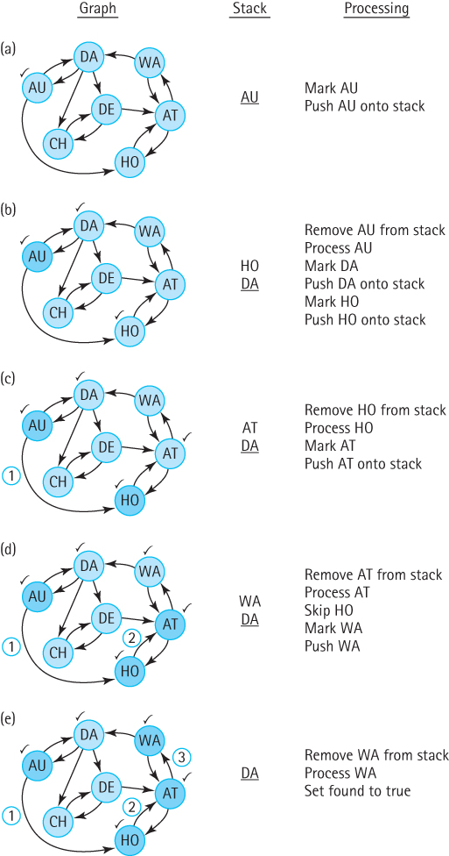
Set found to false
Clear all marks
Mark the startVertex
Push the startVertex onto the stack
do
Set current vertex = stack.top()
stack.pop()
if current vertex equals endVertex
Set found to true
else
for each adjacent vertex
if adjacent vertex is not marked
Mark the adjacent vertex and
Push it onto the stack
while !stack.isEmpty() AND !found
return found

Slide 31
Breadth first search – use queue
IsPathBF (startVertex, endVertex): returns boolean
Set found to false
Clear all marks
Mark the startVertex
Enqueue the startVertex into the queue
do
Set current vertex = queue.dequeue()
if current vertex equals endVertex
Set found to true
else
for each adjacent vertex
if adjacent vertex is not marked
Mark the adjacent vertex and
Enqueue it into the queue
while !queue.isEmpty() AND !found
return found

Slide 32
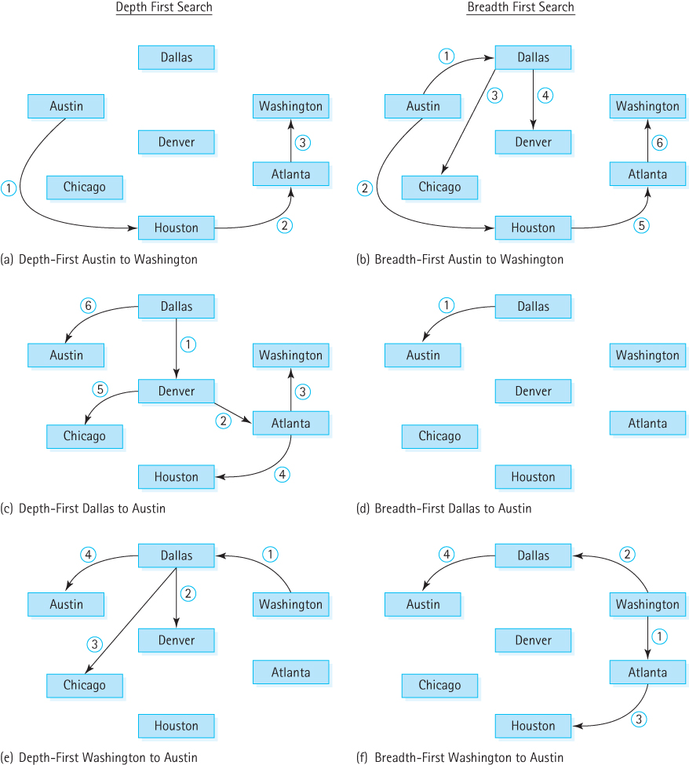
Examples of
search paths

Slide 33
10.5 Application: The Single-Source Shortest-Paths Problem
An algorithm that displays the shortest path from a designated starting city to every other city in the graph
In our example graph if the starting point is Washington we should get
Last Vertex Destination Distance
------------------------------------
Washington Washington 0
Washington Atlanta 600
Washington Dallas 1300
Atlanta Houston 1400
Dallas Austin 1500
Dallas Denver 2080
Dallas Chicago 2200

Slide 34
An erroneous approach
shortestPaths(graph, startVertex)
graph.ClearMarks( )
Create flight(startVertex, startVertex, 0)
pq.enqueue(flight) // pq is a priority queue
do
flight = pq.dequeue( )
if flight.getToVertex() is not marked
Mark flight.getToVertex()
Write flight.getFromVertex, flight.getToVertex, flight.getDistance
flight.setFromVertex(flight.getToVertex())
Set minDistance to flight.getDistance()
Get queue vertexQueue of vertices adjacent from flight.getFromVertex()
while more vertices in vertexQueue
Get next vertex from vertexQueue
if vertex not marked
flight.setToVertex(vertex)
flight.setDistance(minDistance + graph.weightIs(flight.getFromVertex(), vertex))
pq.enqueue(flight)
while !pq.isEmpty( )

Slide 35
Notes
The algorithm for the shortest-path traversal is similar to those we used for the depth-first and breadth-first searches, but there are three major differences:
We use a priority queue rather than a FIFO queue or stack
We stop only when there are no more cities to process; there is no destination
It is incorrect if we use a reference-based priority queue improperly!

Slide 36
The Incorrect Part of the Algorithm
while more vertices in vertexQueue
Get next vertex from vertexQueue
if vertex not marked
flight.setToVertex(vertex)
flight.setDistance(minDistance + graph.weightIs(flight.getFromVertex(), vertex))
pq.enqueue(flight)
This part of the algorithm walks through the queue of vertices adjacent to the current vertex, and enqueues Flight objects onto the priority queue pq based on the information.
The flight variable is actually a reference to a Flight object.
Suppose the queue of adjacent vertices has information in it related to the cities Atlanta and Houston.
The first time through this loop we insert information related to Atlanta in flight and enqueue it in pq.
But the next time through the loop we make changes to the Flight object referenced by flight. We are inadvertently reaching into the priority queue and changing one of its entries.

Slide 37
Correcting the Algorithm
while more vertices in vertexQueue
Get next vertex from vertexQueue
if vertex not marked
Set newDistance to minDistance + graph.weightIs(flight.getFromVertex(), vertex)
Create newFlight(flight.getFromVertex(), vertex, newDistance)
pq.enqueue(newFlight)
The application UseGraph in the ch10.apps package
contains the code for all the algorithms presented in
Sections 10.4 and 10.5

Slide 38
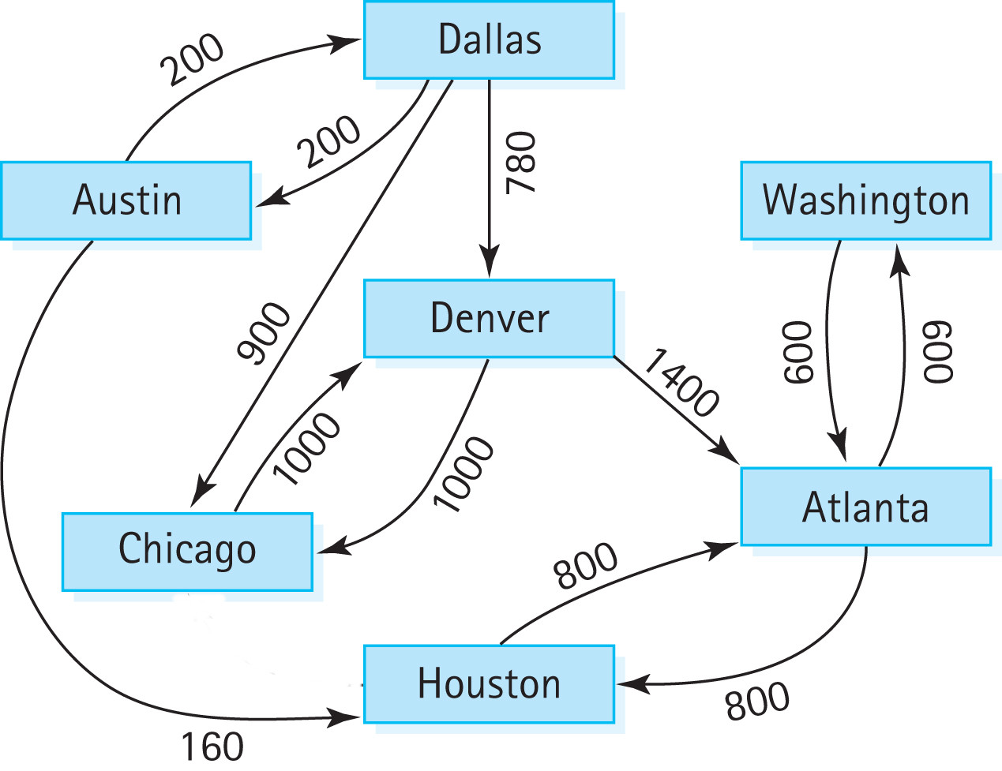
Unreachable Vertices
With this new graph we cannot fly from Washington to
Austin, Chicago, Dallas, or Denver

Slide 39
To print unreachable vertices
Append the following to the shortestPaths method:
System.out.println("The unreachable vertices are:");
vertex = graph.getUnmarked();
while (vertex != null)
{
System.out.println(vertex);
graph.markVertex(vertex);
vertex = graph.getUnmarked();
}

